Slide 1
Valorant Agents Dataset Analysis
File created on: 5/23/2023 7:54:05 AM

Slide 2
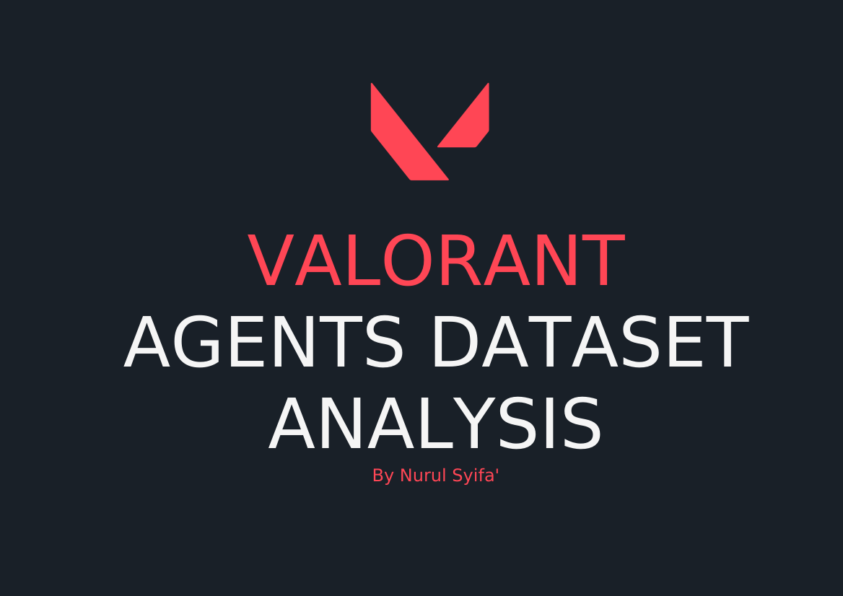

Slide 3
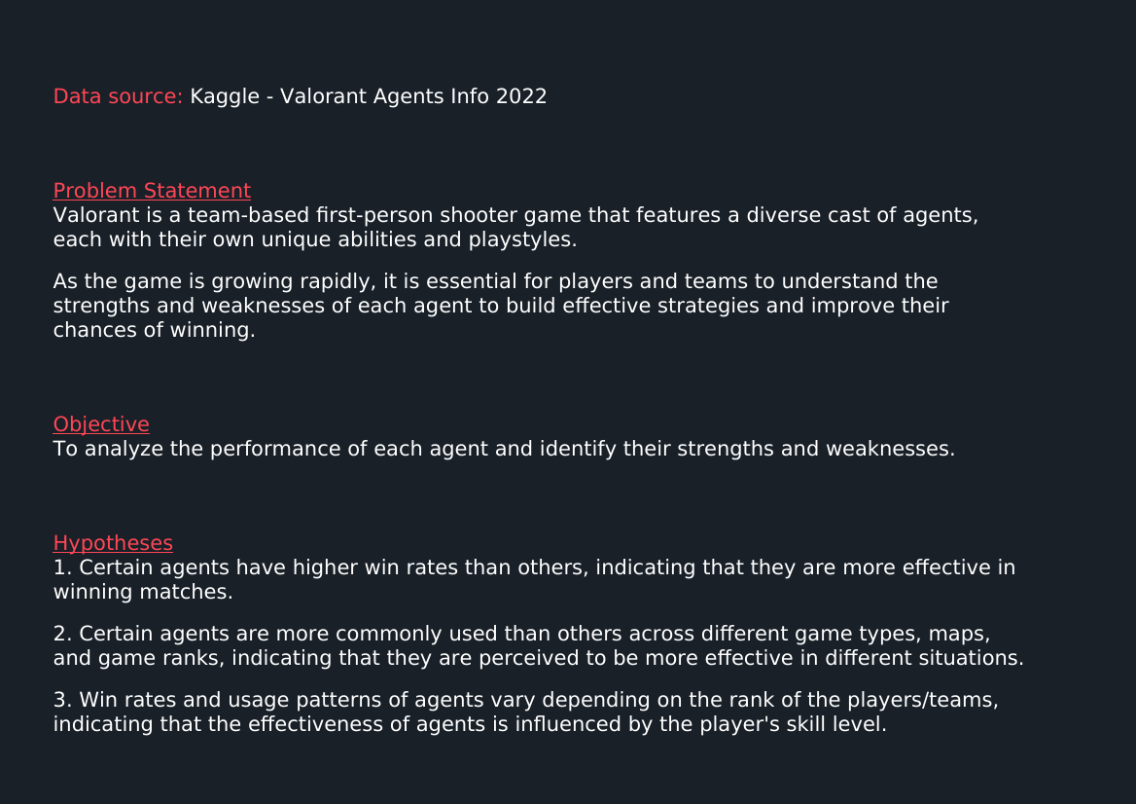

Slide 4
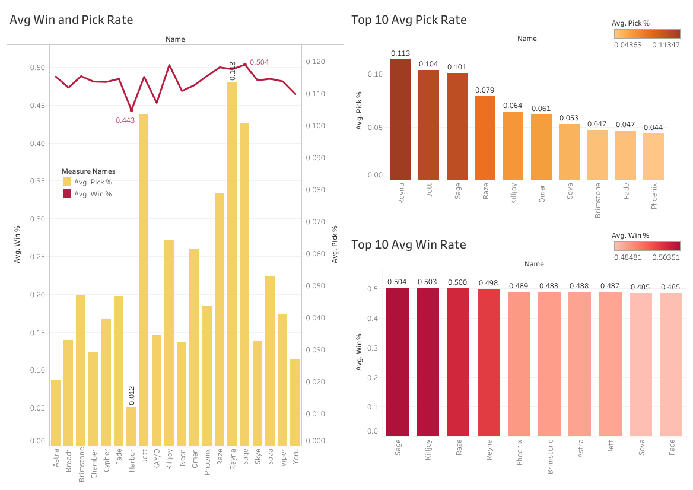

Slide 5
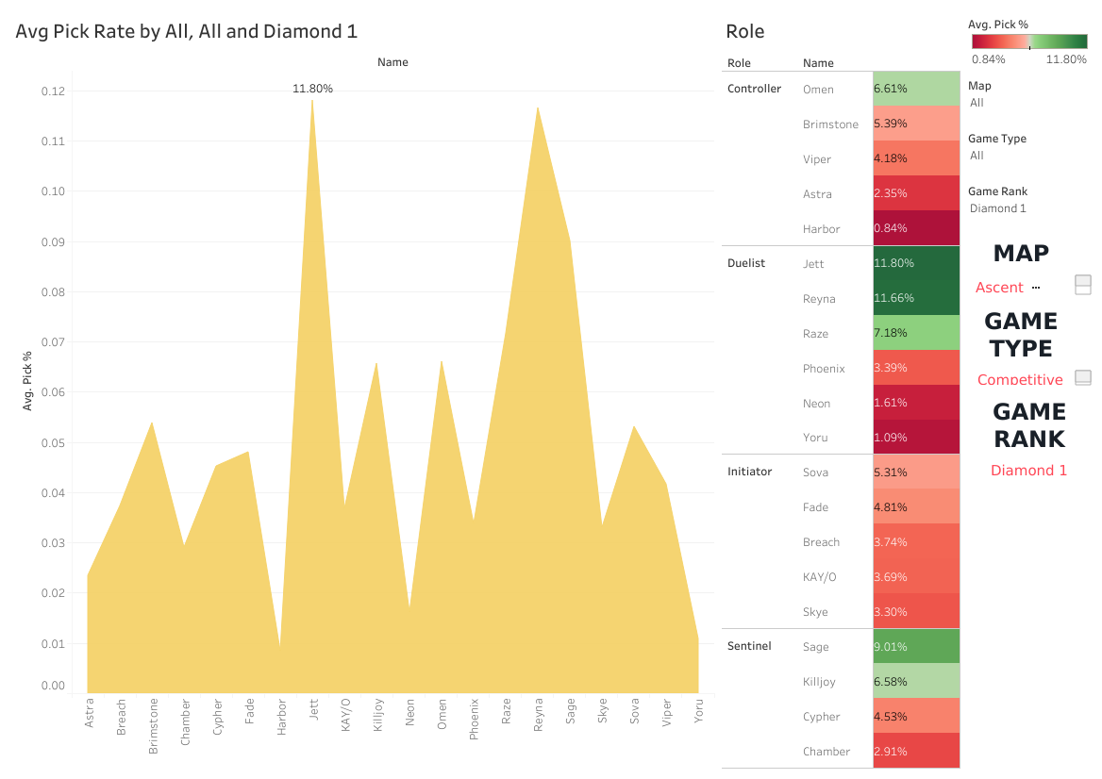

Slide 6
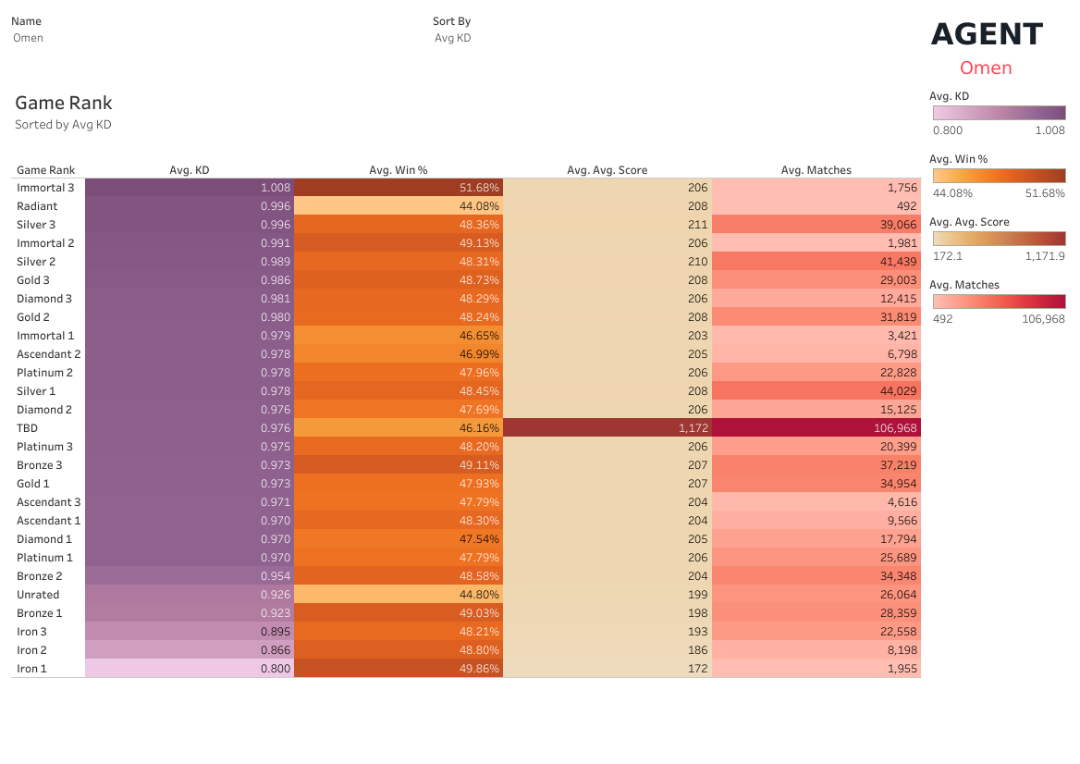

Slide 7
